Slide 1


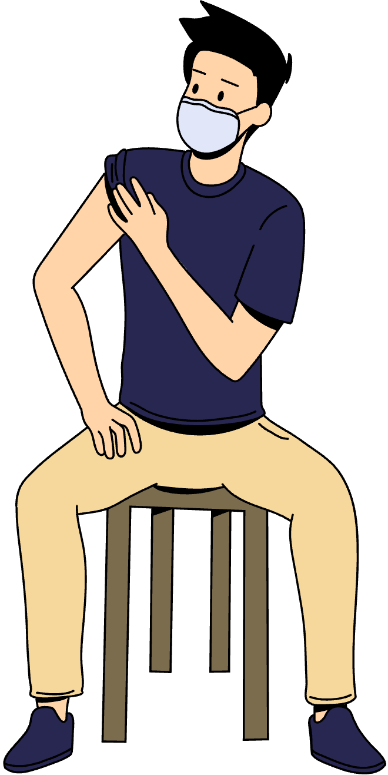
VitalsIQ
Your Personal Health Analyzer

Slide 2
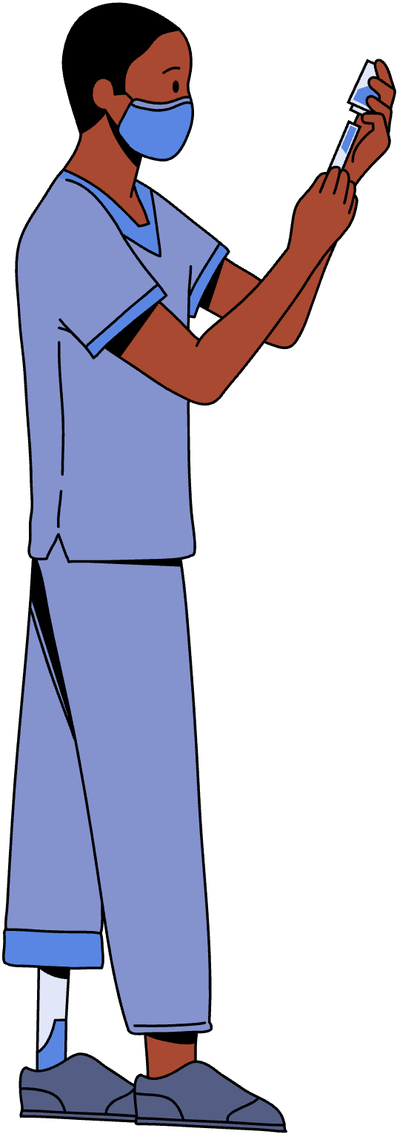

Overview
01
INTRODUCTION
02
PROBLEM STATEMENT
03
OBJECTIVES, SCOPE
04
METHODOLOGY
05
OUTCOME

Slide 3


INTRODUCTION
What is VitalsIQ?
A cutting-edge, OCR-powered health analysis platform designed to revolutionize personal health management.
Simplifies cryptic medical reports by translating jargon and numbers into clear, personalized, and actionable insights for users of all backgrounds.
Core Functionality
Allows users to upload scanned medical reports or enter manual details, for immediate and accurate health metric extraction.
Analyzes key parameters like cholesterol, blood sugar, and heart rate, delivering tailored recommendations to support informed health decisions.
Mission
Aims to democratize health insights, ensuring complex medical data is accessible and understandable to everyone, not just medical professionals.
Empowers individuals to take control of their wellness journey by providing tools to monitor vitals and detect potential health risks early.

Slide 4
How It Works
Utilizes Marker OCR to meticulously extract health parameters from uploaded reports with pinpoint accuracy, ensuring reliable data capture.
Leverages Gemini APIs to structure data, identify trends, flag risks, and generate personalized health advice that feels like a doctor’s consultation.
Technical Backbone
Features a sleek, responsive web interface developed using HTML, CSS, JavaScript, and powered by a robust Python Flask backend for seamless performance.
Designed for accessibility, offering an intuitive experience across devices, whether on a smartphone, tablet, or computer.
Why VitalsIQ Stands Out
Combines user-friendly design with AI-driven precision to deliver trustworthy health assessments that cater to both tech-savvy and novice users.
Built with a scalable vision, planning to expand support for additional health metrics, enhance AI capabilities, and introduce mobile-friendly access globally.

Slide 5
IMPORTANT NUMBERS
88%
51%
Kansas residents lack health understanding.
39%
12%
People struggling with health literacy
Adults proficient in health literacy.
49%
31%
Adults believe medical conspiracies.
Turkish adults lack health skills.
Australians find health info easy.
These statistics reflect real data from studies conducted between 2018 and 2024

Slide 6
Overview
01
INTRODUCTION
02
PROBLEM STATEMENT
03
OBJECTIVES, SCOPE
04
METHODOLOGY
05
OUTCOME

Slide 7
PROBLEM STATEMENT
Challenge of Medical Reports
Medical reports are often a confusing maze of technical jargon, complex numbers, and stats that feel like a foreign language to most people.
Deciphering critical health metrics like cholesterol, glucose, or blood pressure is a significant struggle for the average person without medical training.
Health Literacy Gap
Limited understanding of health data leads to missed opportunities for early detection of risks and informed wellness decisions.
This gap leaves individuals disconnected from their own health, relying on overbooked doctors or unreliable online searches for clarity.
Inadequate Tools
Existing tools are designed for medical professionals, are difficult to navigate, or provide raw data without meaningful, personalized guidance.
There’s a lack of user-friendly solutions that simplify complex medical information and make it actionable for everyday users.

Slide 8
User Disconnect
People feel alienated from their health data, unable to independently understand or act on their medical reports without expert intervention.
This dependency creates frustration and hinders proactive health management, leaving users feeling powerless over their wellness journey.
Need for a Solution
There’s a critical demand for a platform that translates complex medical reports into plain English and delivers clear, AI-powered insights.
Users need a tool that not only analyzes health parameters but also provides actionable recommendations tailored to their unique needs.

Slide 9
Overview
01
INTRODUCTION
02
PROBLEM STATEMENT
03
OBJECTIVES, SCOPE
04
METHODOLOGY
05
OUTCOME

Slide 10

OBJECTIVES, SCOPE
Objectives:
Simplify medical reports for non-experts with user-friendly platform.
Use Marker OCR for accurate health metric extraction from scans.
Give option for manual entry for analyzing health data.
Apply Gemini APIs for AI-driven trends and personalized advice.
Enhance health literacy via clear, accessible web interface.

Slide 11
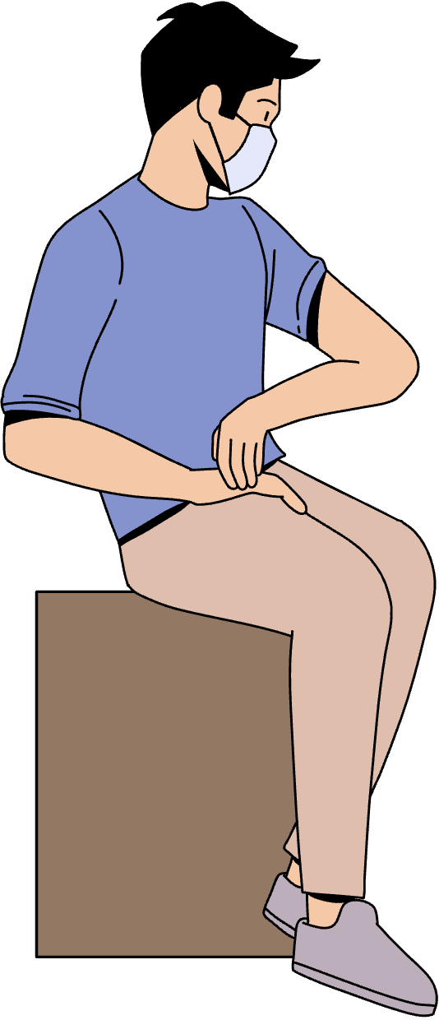
Scope:
Build web app with HTML, CSS,
JavaScript, and Python Flask.
Integrate Gemini APIs for
data structuring and insights.
Design Landing, About Us,
and Analysis pages for users.
Accept user pdf health report or
manual entry for analysis.

Slide 12

Overview
01
INTRODUCTION
02
PROBLEM STATEMENT
03
OBJECTIVES, SCOPE
04
METHODOLOGY
05
OUTCOME

Slide 13
METHODOLOGY
Challenge of Medical Reports
Medical reports are often a confusing maze of technical jargon, complex numbers, and stats that feel like a foreign language to most people.
Deciphering critical health metrics like cholesterol, glucose, or blood pressure is a significant struggle for the average person without medical training.
Health Literacy Gap
Limited understanding of health data leads to missed opportunities for early detection of risks and informed wellness decisions.
This gap leaves individuals disconnected from their own health, relying on overbooked doctors or unreliable online searches for clarity.
Inadequate Tools
Existing tools are designed for medical professionals, are difficult to navigate, or provide raw data without meaningful, personalized guidance.
There’s a lack of user-friendly solutions that simplify complex medical information and make it actionable for everyday users.

Slide 14
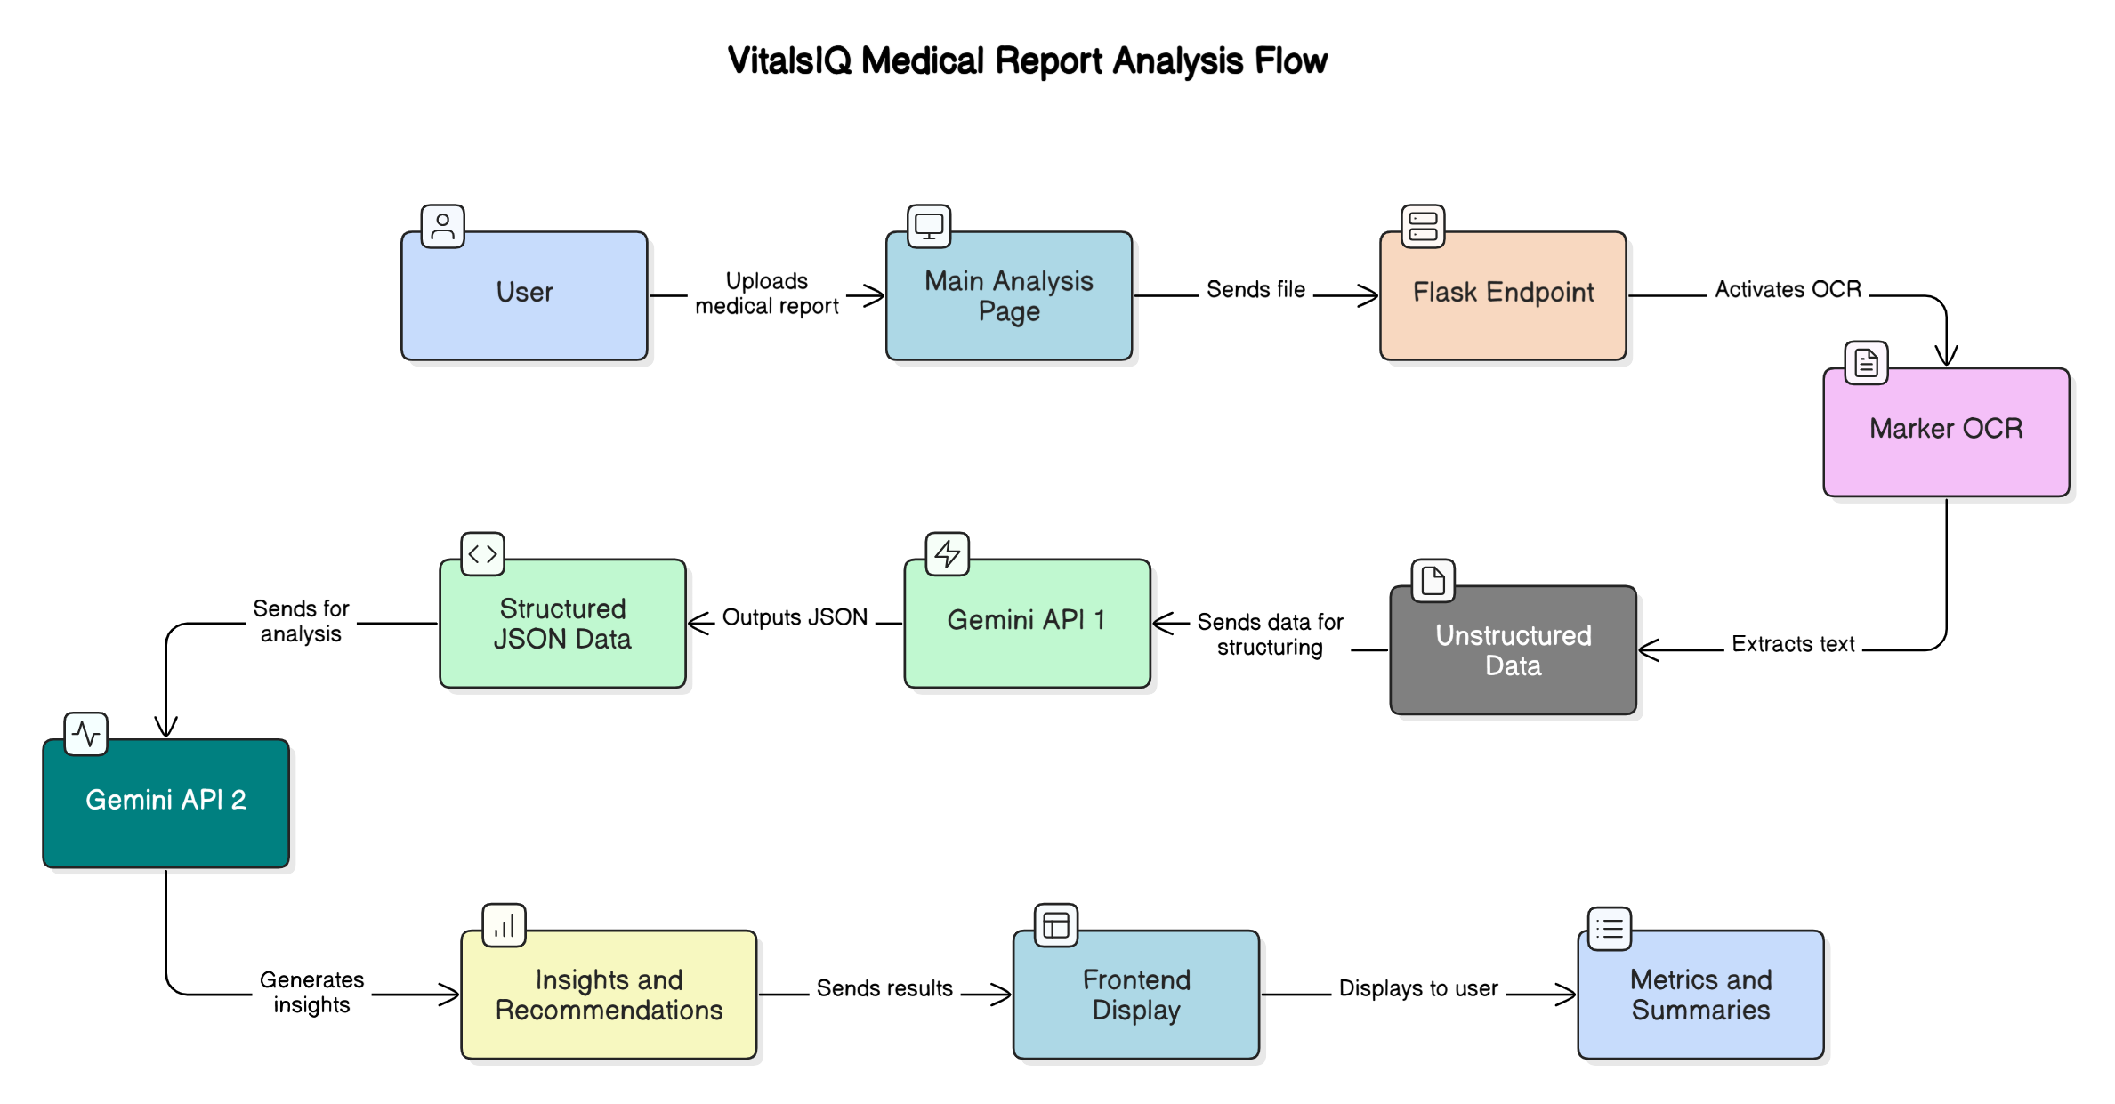

Slide 15
Overview
01
INTRODUCTION
02
PROBLEM STATEMENT
03
OBJECTIVES, SCOPE
04
METHODOLOGY
05
OUTCOME

Slide 16
OUTCOME
Seamless Web Development
Created user-friendly UI with HTML, CSS, and JavaScript.
Developed Flask backend for uploads and API workflows.
Designed Landing, About, and Analysis pages effectively.
AI-Powered Health Analysis
Built end-to-end system for report processing and insights.
Integrated Gemini APIs for data structuring and risk assessment.
Enabled non-experts to grasp complex health metrics easily.
Robust OCR Integration
Implemented Marker OCR for accurate health parameter extraction.
Supported diverse report formats with reliable text recognition.
Optimized pipeline for varying image quality consistency.

Slide 17
Efficient API Workflow
Designed RESTful endpoints for uploads and results.
Ensured smooth frontend-backend data flow and rendering.
Tested APIs with Postman for performance and errors.
Scalable System Foundation
Prepared for future health metric additions and AI models.
Built extensible codebase for potential mobile enhancements.
Established scalable architecture for long-term growth.
Enhanced Skills
Solved OCR inconsistency and API limit challenges.
Debugged data parsing for accurate metric extraction.
Mastered Git and GitHub for versioning and collaboration.

Slide 18
PROJECT PHOTOS:

Slide 19
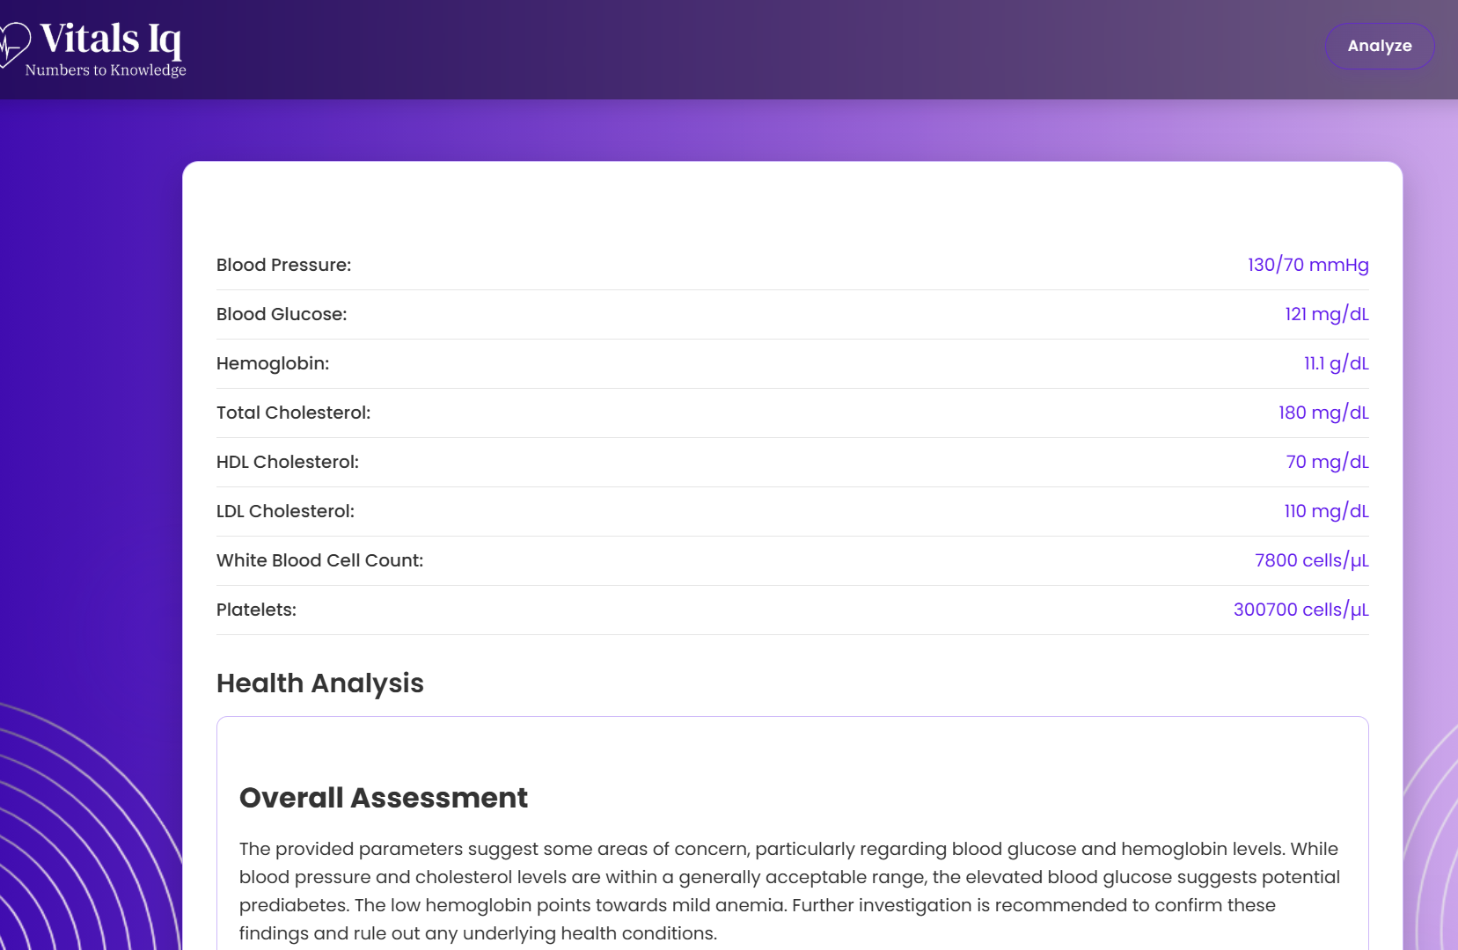
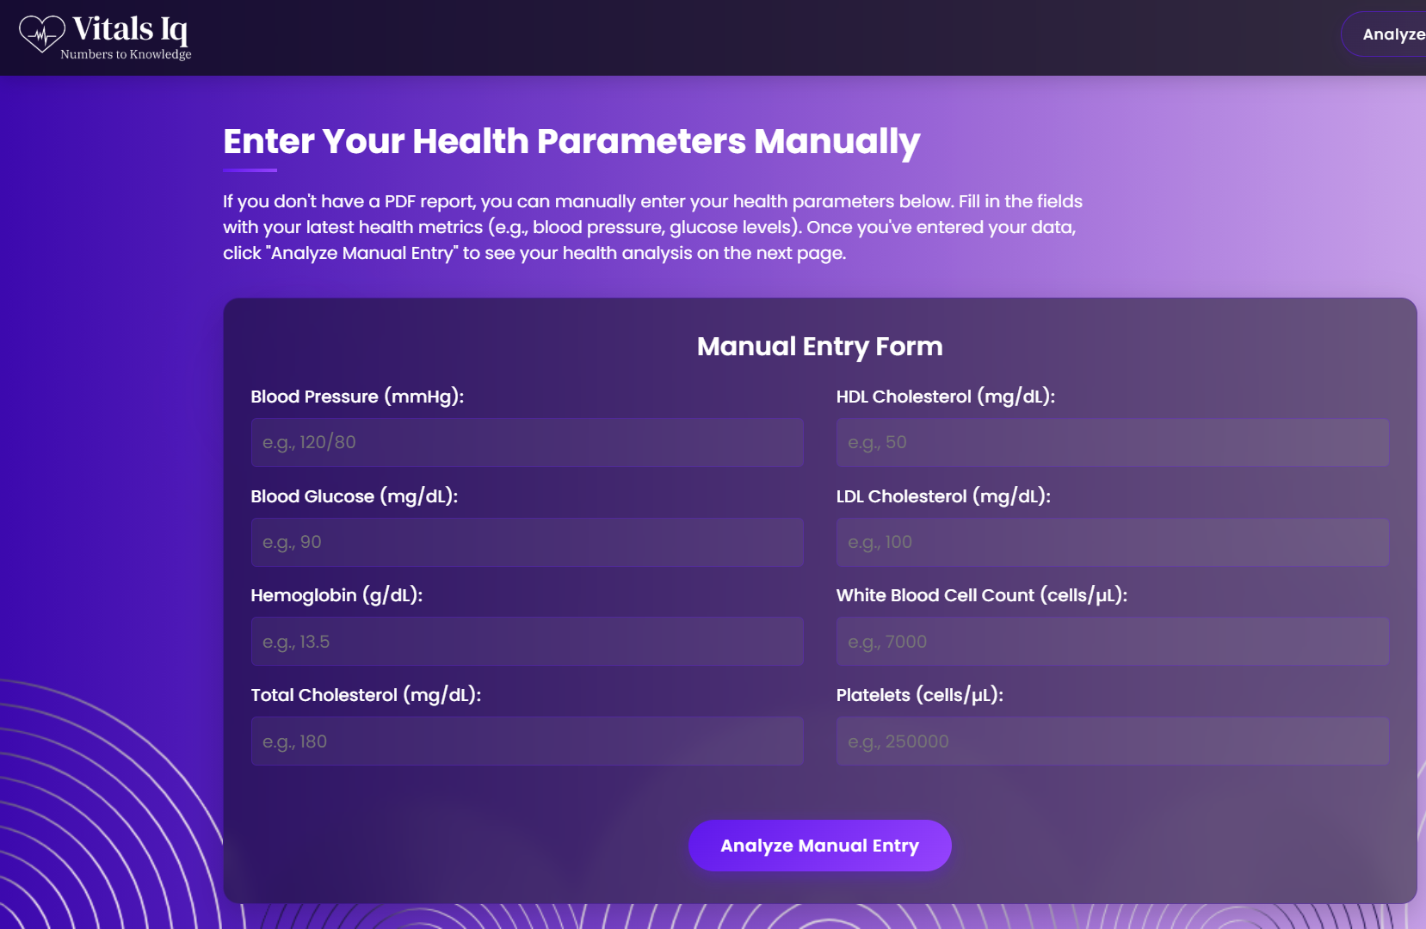
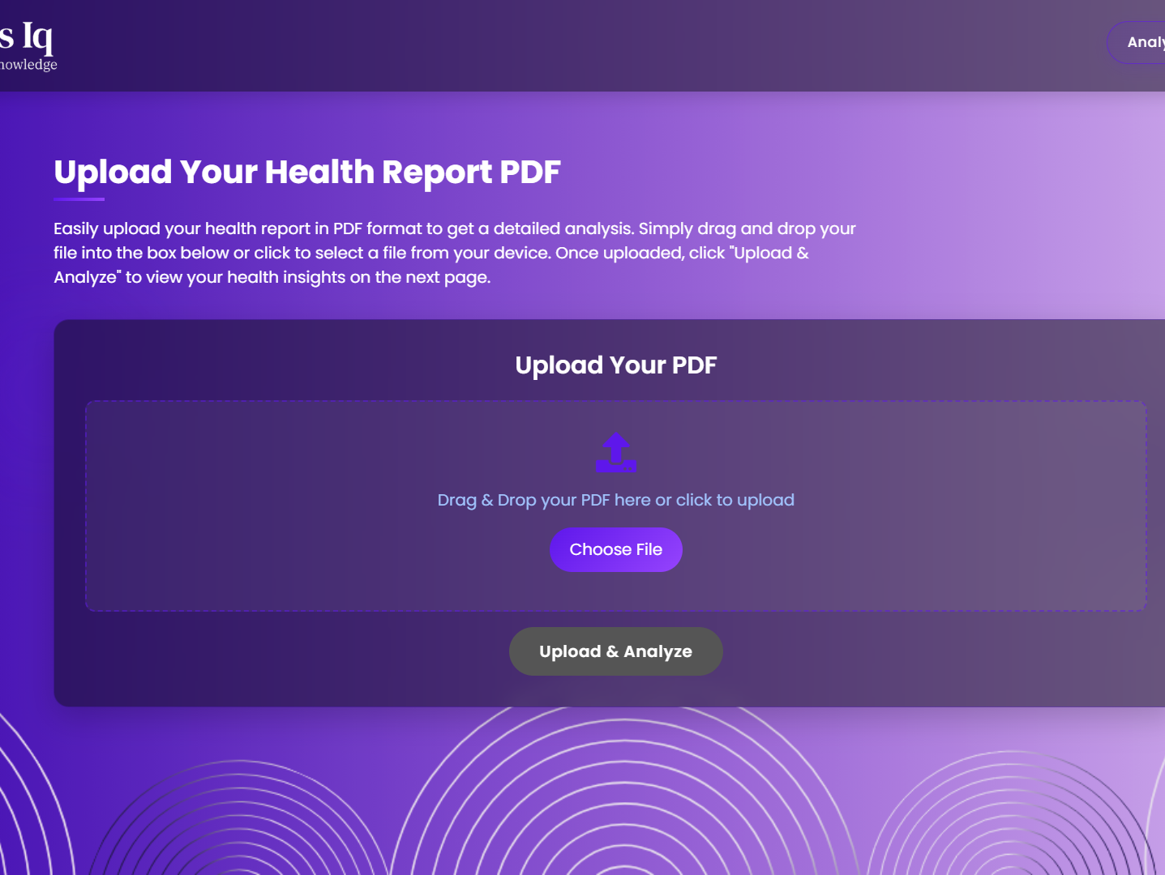
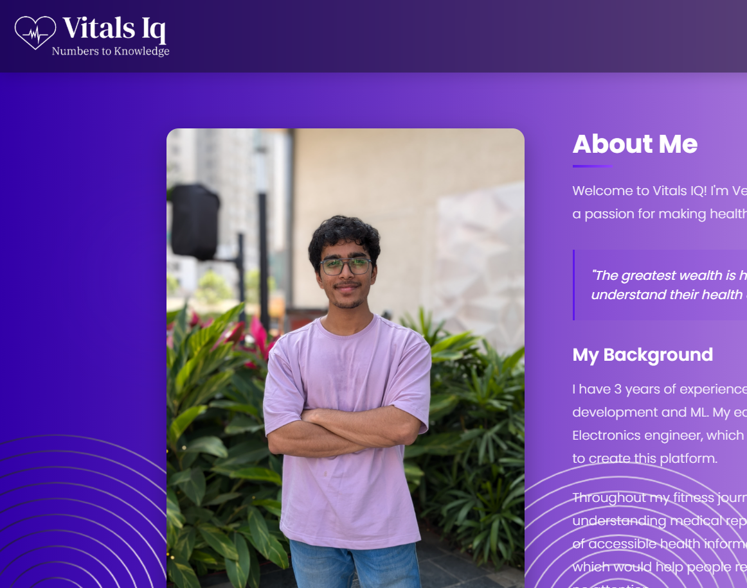
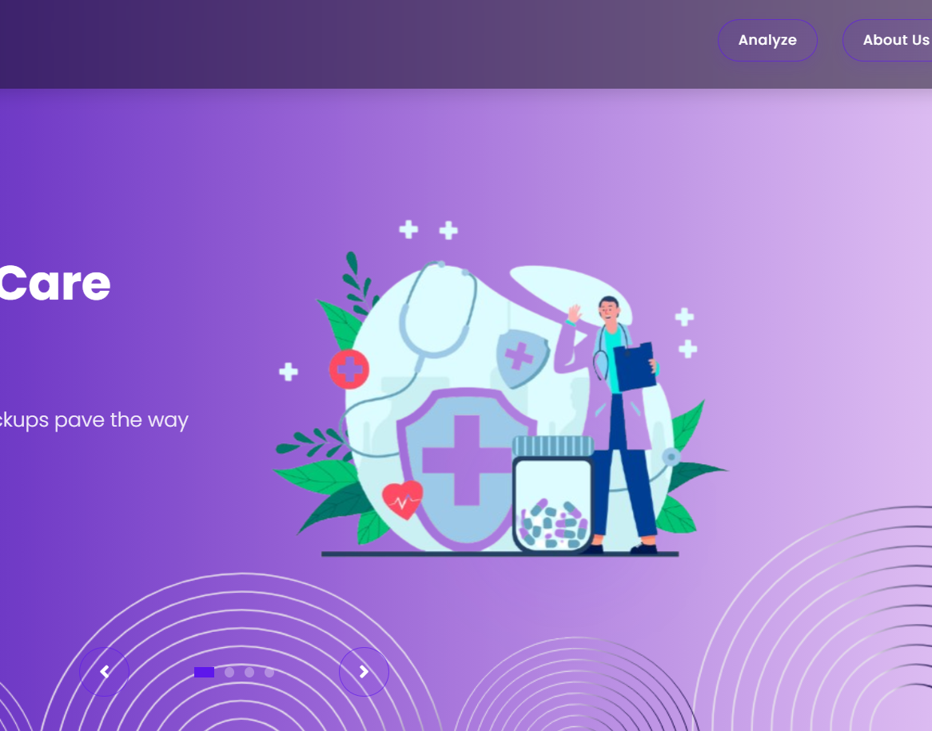

Slide 20

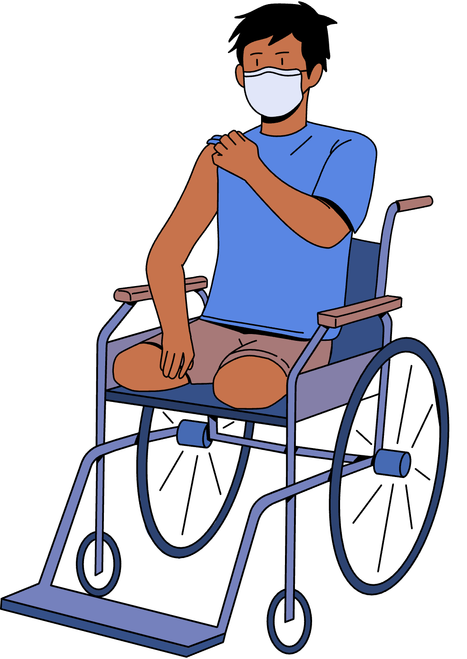
END OF PRESENTATION
Thank You!

